Slide 1
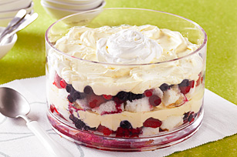
Desserts by Design.
Created by Dr. Vivian G. Baglien

Slide 2
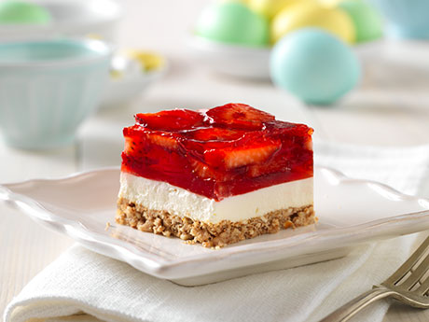
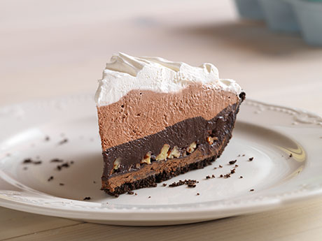
Desserts combining several components presented in a manner similar to the main meal are called plated desserts.
Both size and shape of plates and colors and patterns must be taken into account for the presentation.

Slide 4
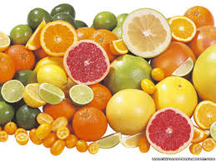
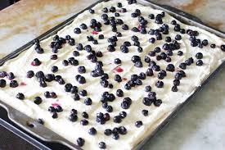
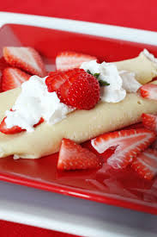
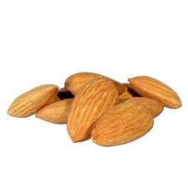
Citrus- Lemons, Lime, Oranges
Compliments….

Slide 5
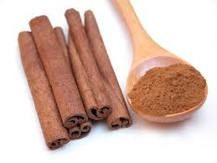
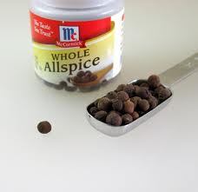
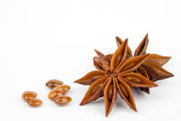
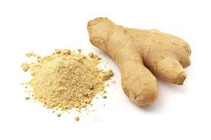
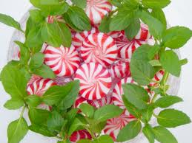
Spices That Give Desserts Unique Flavor
Cinnamon
Anise
Pears, Apples, Tree Fruits
Chocolate, Apples, Pears, Caramel
Almonds, Sweet Cream
Ginger
Peppermint
Most fruit and berries, including apricot, pears and lemon
Chocolate and Sweet Cream

Slide 6
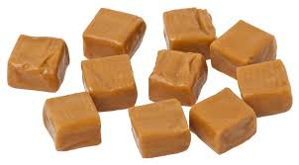
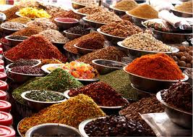
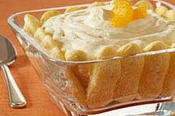
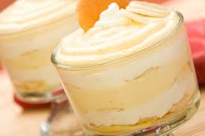
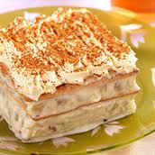
Caramel
Most Spices, sweet or tart creamy products, pears and apples.

Slide 7
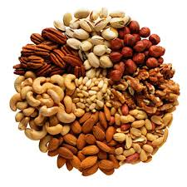
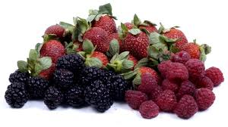
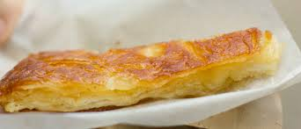
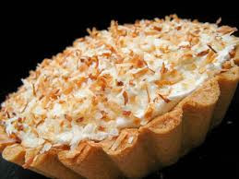
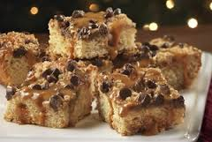
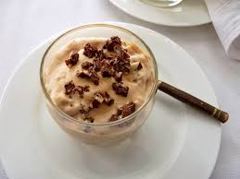
Nuts added to…
Raw Nuts:
Toasted Nuts:

Slide 8
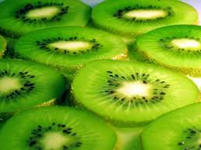
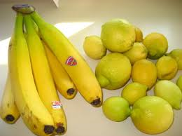
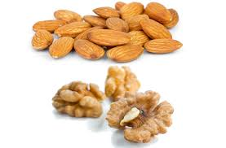
Iron Chef- Ingredients Raw

Slide 9
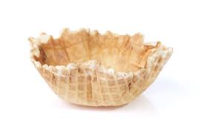
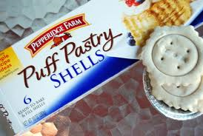
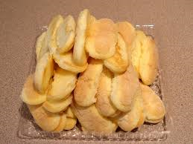
Iron Chef Ingredients Bases

Slide 10
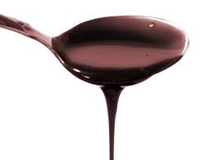
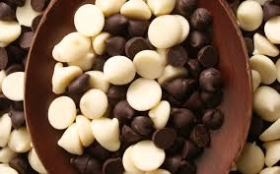
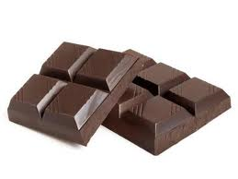
Chocolate…..

Slide 11
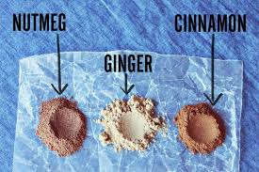
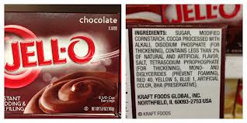
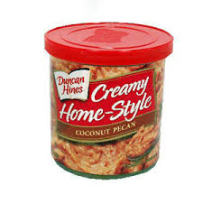
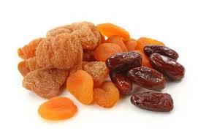
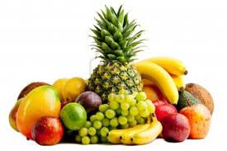
Mystery Ingredients?

Slide 12
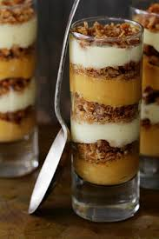
Final Steps….
Collaborate with your kitchen and find a demo recipe that will serve 6- (Your judges)
Make three copies, keep two and give one to Dr. Baglien
Decide who is main chef(s)
You may bring two ingredients from home
Any supplies available in the room can be used in your Iron Chef Demo, but must be indicated in your recipe.
Presentations:
Day 1
Kitchens- 1, 3,5,7 Demo
Kitchens 2, 4, 6 Judges
Day 2
Kitchens 2,4, 6 Demo
Kitchens 1,3, 5, 7 Judges

Slide 13
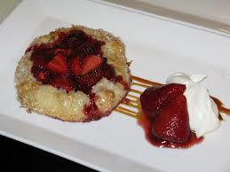
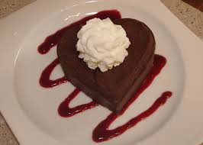
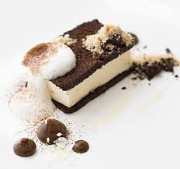
Plate Your Dessert- one for each Judge

Slide 14
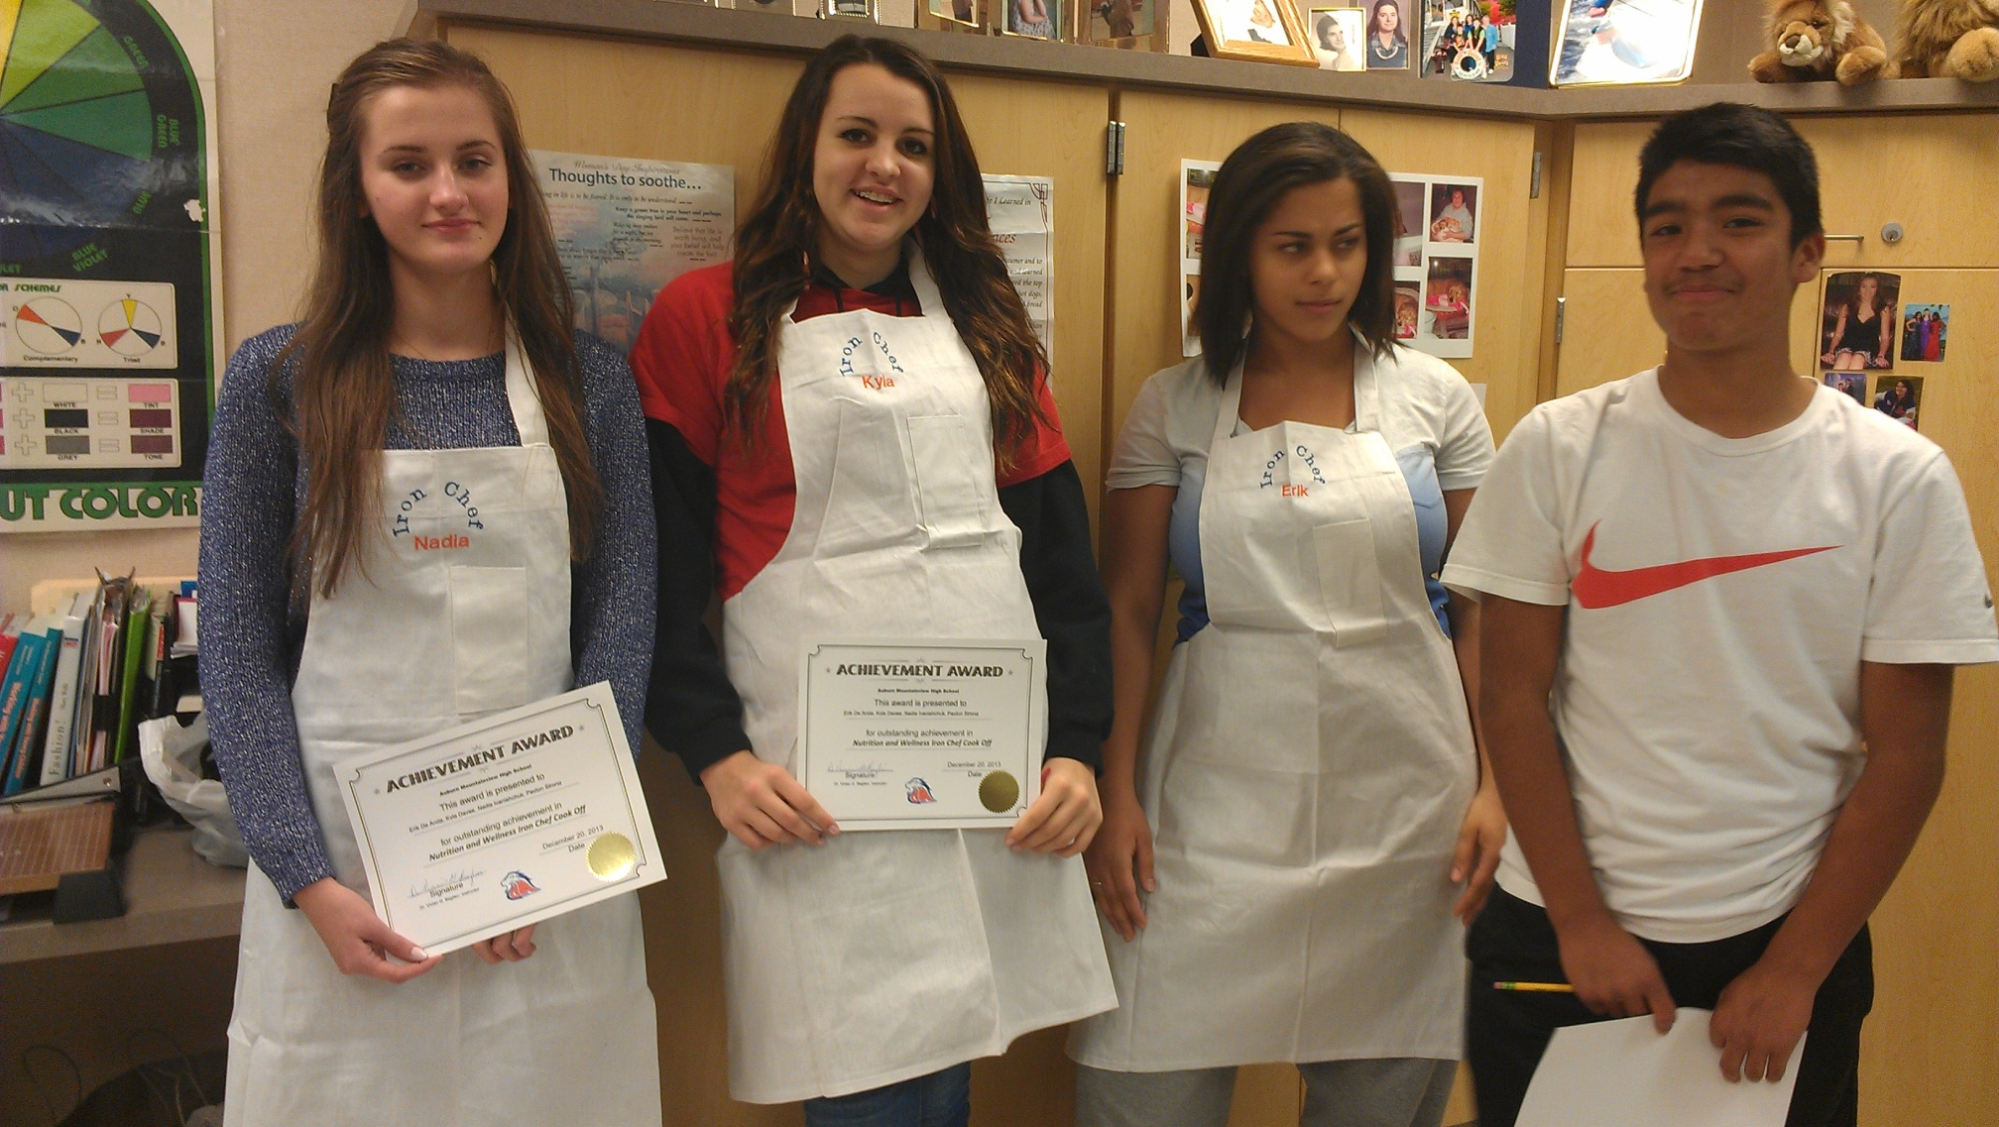
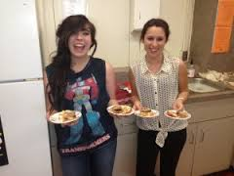
Will your team be the Iron Chefs?

