Slide 1
Kitchen Counter Tops
Dr. Vivian G. Baglien
Adapted from:
http://www.houzz.com/ideabooks/1623075/list/Kitchen-Countertops-101--Choosing-a-Surface-Material

Slide 2
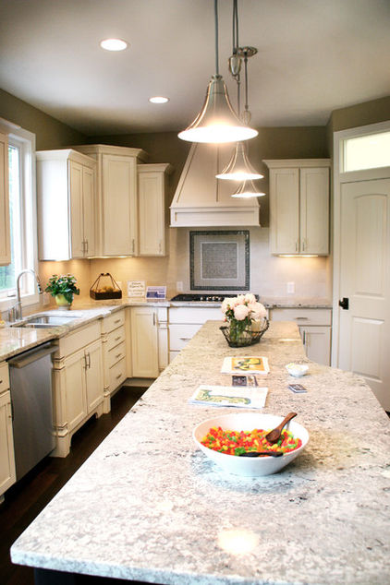
Granite
Cost: $35 to $100 per square foot, installed

Slide 3
Granite Pros and Cons
Pros:
Beautiful
Durable
Resists heat and stains
Needs little maintenance
Cons:
Hard material; glass will shatter if dropped on it.
Expensive
Has colder feeling than softer stones.
Needs periodic sealing to protect surface

Slide 4
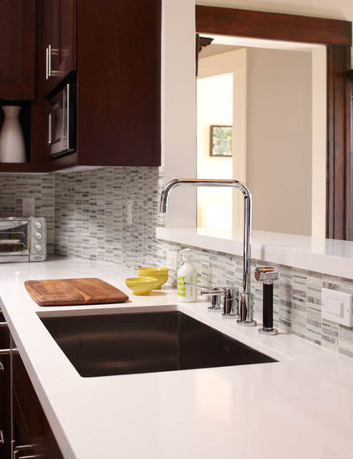
SOLID SURFACING
Cost: $35 to $100 per square foot, installed

Slide 5
SOLID SURFACING PROS & CONS
Pros
Cons
virtually maintenance free —
no sealing
scratches and burns are easy to sand out.
Color and pattern options are extensive,
can experiment with vibrant hues such as turquoise or tomato red.
Seamless installation means there are no cracks to trap dirt
artificial look and feel,
approach the price of natural stone.
doesn't stand up to hot pans or sharp knives as well as other materials.

Slide 6
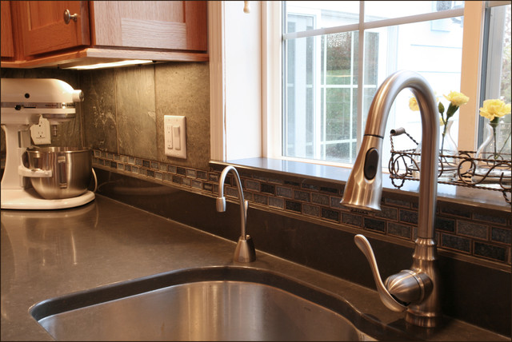
Quartz Surfacing
Cost: $40 to $90 per square foot, installed

Slide 7
Quartz Pros & Cons
Pros
Cons
Low maintenance.
Available in a far greater range of colors and patterns than natural stone.
Its durability can make it a good investment
May look an engineered product.
It's relatively pricey,.

Slide 8
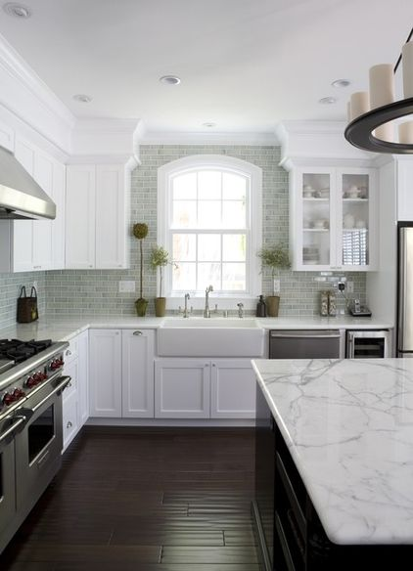
Marble
Cost: $40 to $100 per square foot, installed

Slide 9
Marble Pros & Cons
Pros
Cons
Nothing beats marble for sheer elegance.
It stands up to heat well,
remains perennially cool, it's a traditional choice for pastry and baking stations
Marble is very susceptible to stains, even with sealing.
For that reason, it's not often used throughout an entire kitchen
Most homeowners limit it to one or two small areas.
Can also scratch and chip.

Slide 10
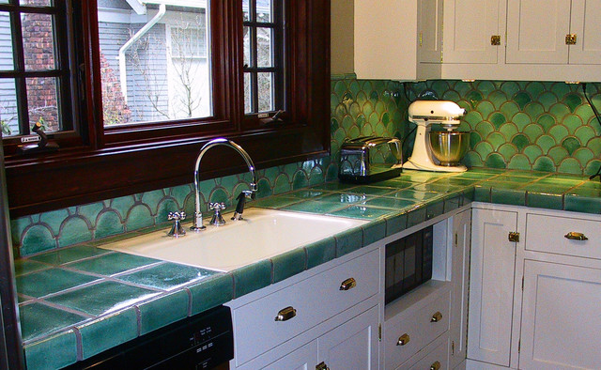
Tile
Cost: $10 to $80 per square foot, installed

Slide 11
Tile Pros and Cons
Pros
Cons
Holds its own against heat and sharp blades,
resists stains.
Chipped or cracked tiles are easy to replace.
Uneven surface can make it difficult to balance a cutting board or roll out a pie crust.
Unsealed grout is prone to staining
standing moisture can damage it and contribute to bacterial growth.

Slide 12
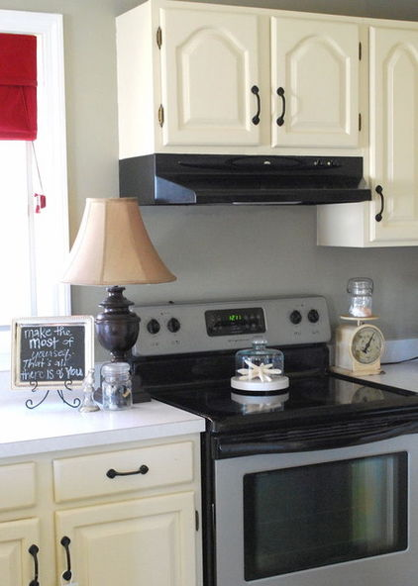
Laminate
Cost: $10 to $30 per square foot, installed

Slide 13
Laminate Pros and Cons
Pros
Cons
prone to scratching, burns and staining
With wear and moisture exposure, layers can peel.
Because of the raw particle board core, you can't use laminate with undermount sinks,
also difficult to repair if damaged
Most affordable countertop materials
Low maintenance and easy to clean.
Light weight doesn't require the support of a thick cabinet base.

Slide 14
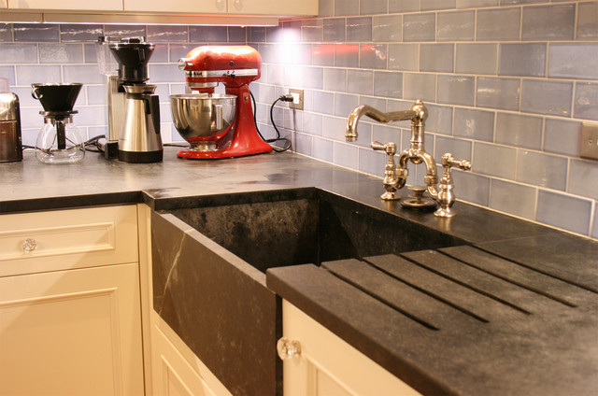
Soapstone
Cost: $70 to $100 per square foot, installed

Slide 15
Soapstone Pros and Cons
Has a natural softness and depth that fits very well with older and cottage-style homes.
Usually starts out light to medium gray, it darkens with time.
(Most people enjoy the acquired patina, but you may consider this a con.)
Needs polishing with oil to keep it in top shape.
Can crack over time, and
Can't handle knife scratches and nicks.
The natural roughness of its surface can scuff glassware and china.

Slide 16
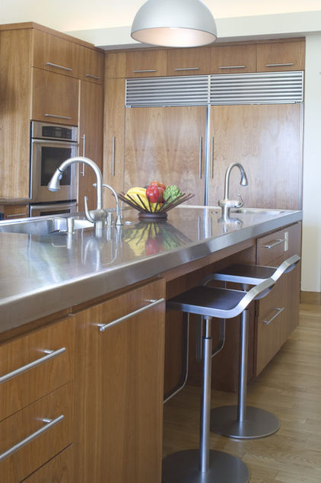
Stainless Steel
Cost: $65 to $125 per square foot, installed

Slide 17
Stainless Steel Pros and Cons
It's nearly indestructible,
resists heat and bacteria.
provides a very distinctive look that feels appropriate in contemporary and industrial-style kitchens.
Fingerprints show and must be wiped off frequently,
Stainless steel can also dent.
Can be loud as pots, pans and dishware clang against the surface.
Chemicals can affect its color and cause unwanted etching.
Stainless steel is extremely expensive due to the custom fabrication.

Slide 18
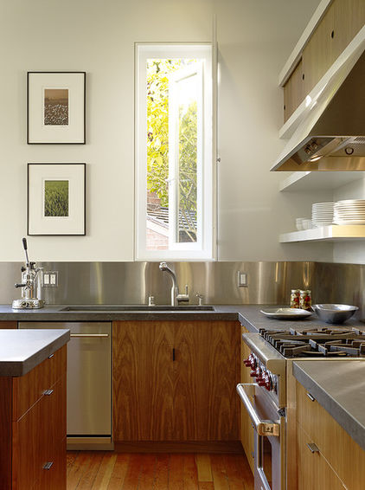
Concrete
Cost: $75 to $125 per square foot, installed

Slide 19
Concrete Pros and Cons
Pros
Cons
Extremely versatile:
Can be cast in any shape and custom tinted any shade you wish
Easily can add unique inlays, such as glass fragments, rocks and shells.
stands up well to heavy use, although it isn't as heat resistant as some other surfaces.
Porous, concrete will stain without frequent sealing.
With time and settling, small cracks can develop.
Extremely heavy and will need strong support beneath.
Like stainless steel, its custom creation ups the price tag.

Slide 20
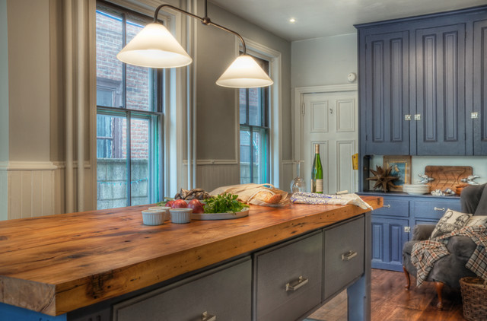
Butcher Block
Cost: $35 to $70 per square foot, installed

Slide 21
Butcher Block Pros and Cons
Pros
Cons
Warm, natural appearance and variegated wood tones.
Many people like the shopworn look it develops
Can also sand scratches down with ease.
Wood swells and contracts with moisture exposure,
Harbors bacteria and needs frequent disinfecting.
Oiling is a must to fill in scratches and protect the surface.

Slide 22
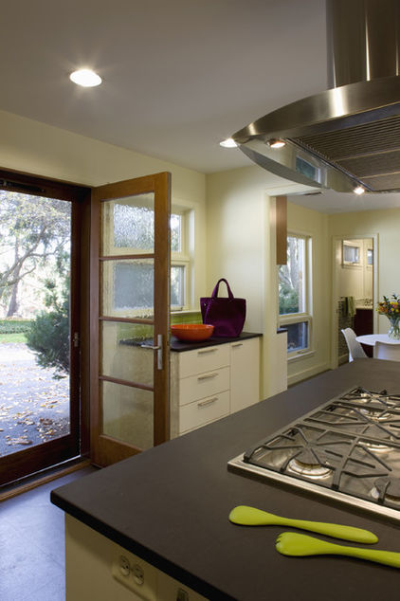
Paper Composite
Cost: $85 to $125 per square foot, installed

Slide 23
Paper Composite Pros and Cons
Paper composite evokes the look of solid surfacing or laminate but with a warmer sensibility.
Surprisingly hardy and can withstand heat and water admirably.
Great deal lighter than natural stone or concrete.
Material isn't scratchproof
Susceptible to chemical damage.
Needs an occasional rubdown with mineral oil, and even sanding, to refresh it.
Although it sounds as if though it would be a lower-budget option- it’s expensive

Slide 24
References
Frederick, L ( n.d.). Kitchen countertops 101: choosing a surface material as retrieved October 25, 2012 from http://www.houzz.com/ideabooks/1623075/list /Kitchen-Countertops-101--Choosing-a- Surface- Material
Nafie, C. ( n.d.) Top 10 kitchen countertops, as retrieved October 25, 2012 from http://interiordec.about.com/od/kitchen counters/tp/tp_countertops.htm

