Slide 1
Gluten in Bread Making & Cool Rise Baking
by: Dr. Vivian G. Baglien
Auburn Mountainview High School
January 6, 2013
Learning Target: Student will identify and apply whole wheat bread making techniques to a whole wheat pizza lab.

Slide 2
THE ROLE OF GLUTEN
Defined: an elastic, mesh-like substance which develops in batter and dough when flour and liquid are combined.
How it Works:
The gluten in the flour develops and becomes
strong and elastic, forming a network of tiny air
cells
Air or steam produced by the leavening agent is trapped by these cells
When heated, the trapped gases expand and the product rises

Slide 3
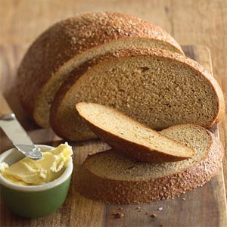
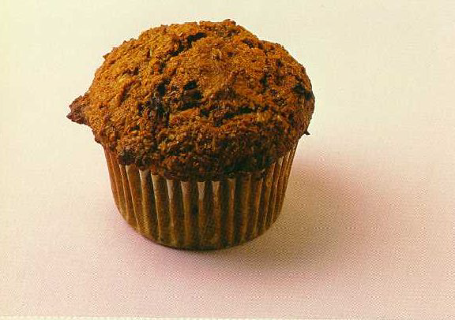
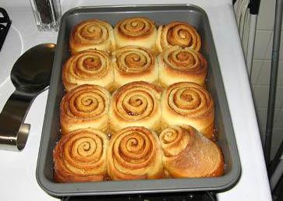
Leavening Agents
LEAVENING
Defined: substances that trigger
chemical actions that cause baked
products to RISE.
3 Basic Leavening Agents
Air
Steam
Chemical
(baking soda & baking powder and yeast)

Slide 4
How to Knead Dough
Defined: working the dough with your
hands to thoroughly mix ingredients
and develop gluten.
Bread can also be kneaded by machine using a food processor along with a dough hook.
Watch and learn!

Slide 5
Steps to Kneading
Turn the dough out on a lightly floured surface.
With the heel of your hands, push down
on the edge of the dough nearest to
you.
Fold the dough in half toward you and
give a quarter turn.
Continue pushing, folding, and turning
for the time directed in the recipe.

Slide 6
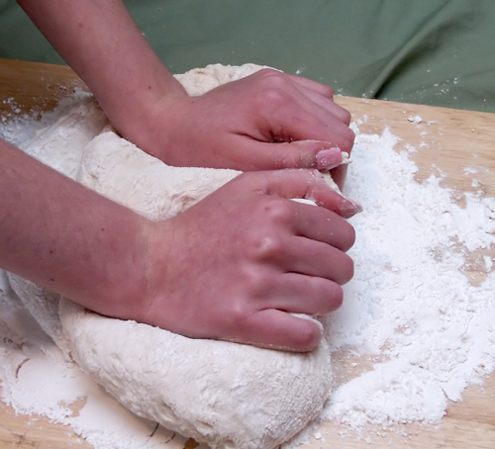
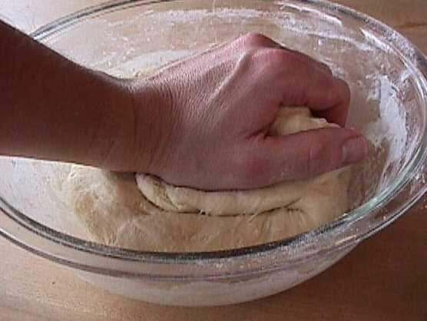
Kneading by hand
Kneading by hand in a floured bowl.
Fold over and knead on floured board.

Slide 7
Machine Kneading
Mix on lower speed to begin.
Use a dough hook

Slide 8
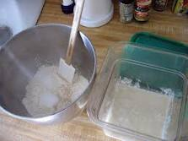
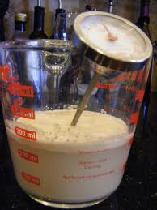
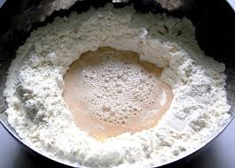
Stage one- mixing ingredients together. Mix at lower speed.
Add dry ingredients to metal Kitchen-aide bowl.
Then add liquid ingredients, yeast should be
Dissolved in water between 110- 120 F’
Use a thermometer to check temperature.
Make a well in flour, add liquids,
then mix with dough hook.

Slide 9
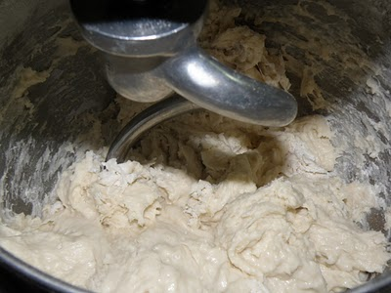
Stage one- continued: Mixing ingredients together: Mix at lower speed.

Slide 10
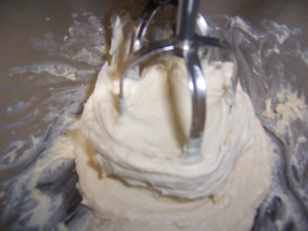
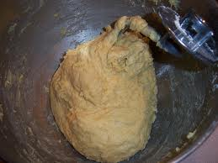
Step Two Mixing to Right Consistency
Dough is still not pulling away from bowl. Add ½ cup more flour.
If mixture is too dry add ¼ cup of water.
Mixing dough- still wet, may need to add more flour. Try ½ cup at a time

Slide 11
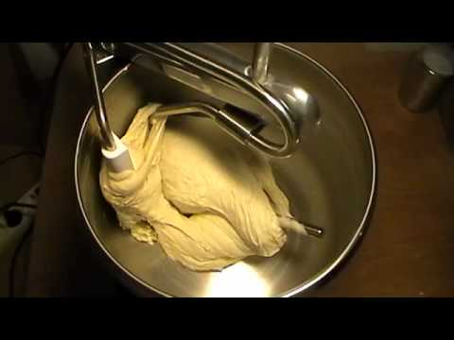
Step Three Monitoring Dough
Dough should pull away clean from bowl and be smooth and elastic.

Slide 12
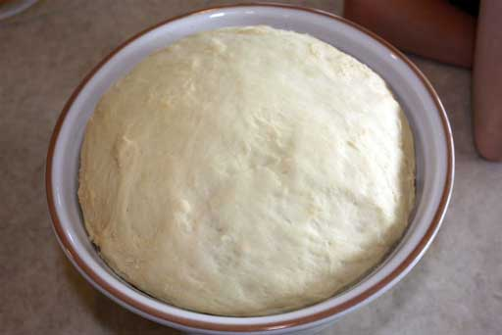
Storing dough in cool rise method
Place dough in large bowl, cover with saran wrap

Slide 13
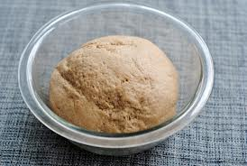
2nd Day Whole Wheat Pizza
Step one- Let the dough sit at room temperature for 15- 30 minutes. (This will be done for you prior to class.)

Slide 14
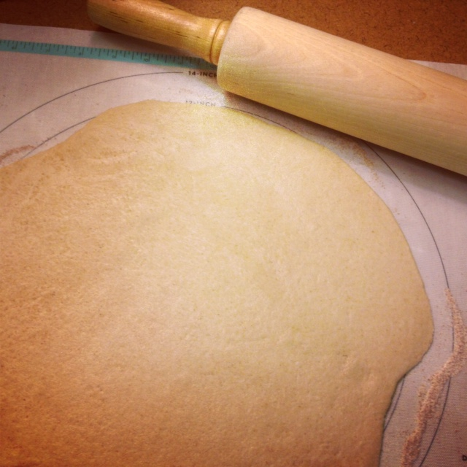
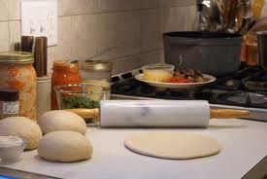
Whole Wheat Pizza-step two
Place dough on oiled surface- plastic cutting board.
Roll out dough to ¼ inch thick and spread first with melted butter, then sprinkle sugar mixture on top.

Slide 15
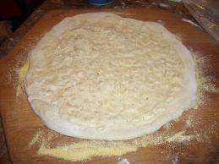
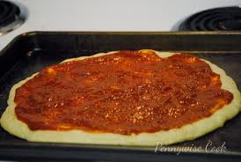
Add base either white or red.
White sauce spread to edge of dough
Red Sauce

Slide 16
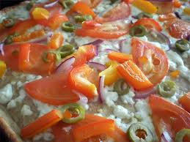
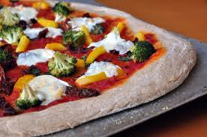
Toppings- must have at least one green veggie!

Slide 17
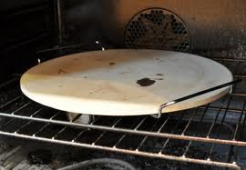
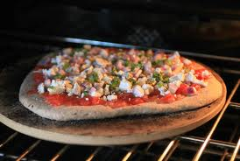
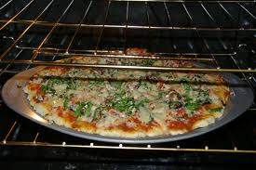
Baking
Heat oven to- 425 Convection
Bake 8- 12 minutes
Place pizza pans in middle of hot oven

Slide 18
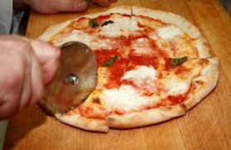
Baking
Bake for 8-12 minutes or until toothpick comes out clean. Enjoy and fill out lab evaluation sheet.

Slide 19
References
(n.d.) As retrieved February 11, 2011 from www.hkhea.org/heency/files/ppt%20of%20pas try%20making.ppt
(n.d.). Quick breads. As retrieved February 11, 2011 from www.d155.org/cg/acad/facs/mcknight/.../quick _breads.pdf .
Baglien, V. FACSE instructor Auburn Mountainview High School. vbaglien@auburn.wednet.edu

Slide 20
Teaching Standards
SL2 Integrate multiple sources of information presented in diverse formats and media (e.g., visually, quantitatively, orally) in order to make informed decisions and solve problems, evaluating the credibility and accuracy of each source and noting any discrepancies among the data. | FCS 9.6 Demonstrate food science, dietetics, and nutrition management principles and practices.

