Slide 1
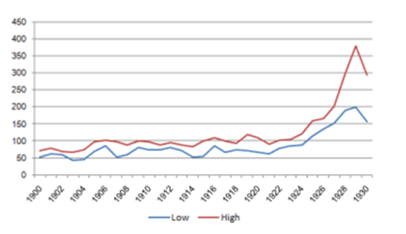
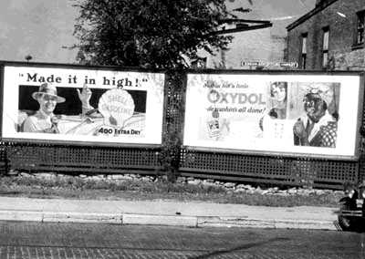
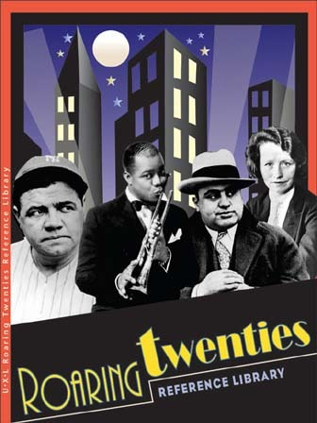
Normalcy and Good Times
A Growing Economy

Slide 2
Learning Targets
By the end of this lesson you will:
Describe an assembly line.
Tell what tradition International Harvester started.
State what Ford’s Sociological Department was created to do.
Understand Ford’s philosophy towards increasing sales.
Describe how the automobile affected American business and society in the 1920s.
Know how most Americans felt about the airplane.
Know how Charles Lindberg changed how Americans felt about the airplane.
Understand welfare capitalism.

Slide 3
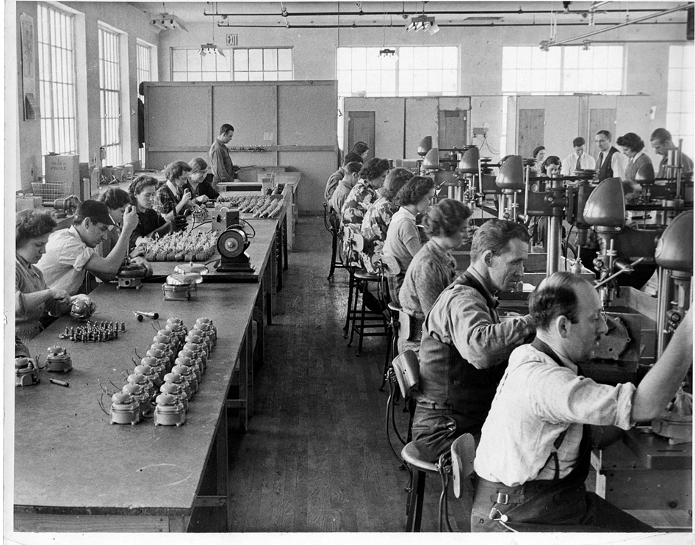
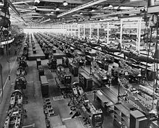
The Rise of New Industries
Mass Production: large-scale product manufacturing usually done by machinery
Created more supply
Reduced consumer cost
Notes:
• •

Slide 4
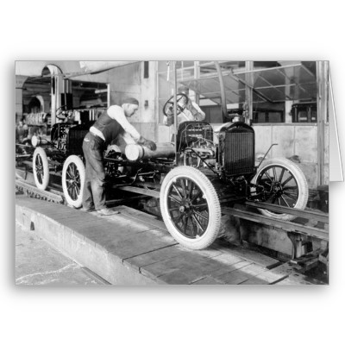
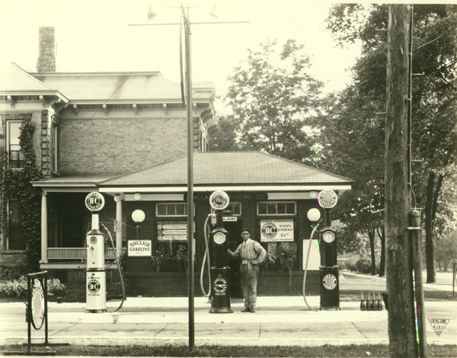
The Social Impact of the Car
The Assembly Line: divided operations into simple tasks that unskilled workers could perform and cut unnecessary motion to a minimum
Henry Ford’s philosophy was to lower the price of the car
In 1912 a car took 12 hours to build and it cost $850
In 1925 a car was finished every 10 seconds and cost $295!
The automobile became available to millions of Americans.
The car created new enterprises such as garages and gas stations.
Rural life was less isolated.
People could now commute greater distances to work.
Notes:
••••

Slide 5
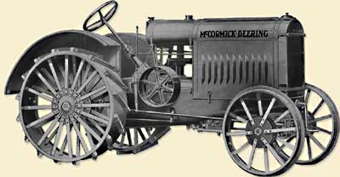
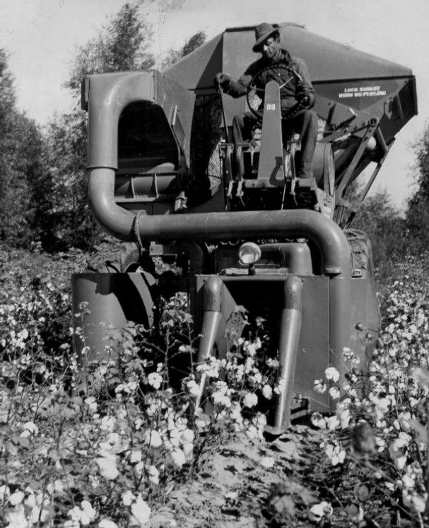
New Working Norms
International Harvester
Maker of trucks, tractors, and other farm machinery
Instituted an annual two-week paid vacation for employees
Ford Motor Company
Began a sociological department to set requirements workers had to meet

Slide 6
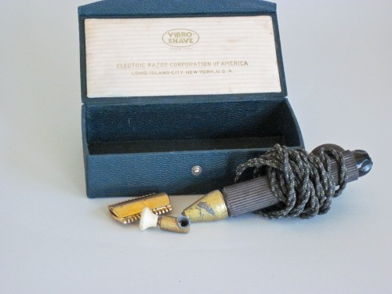
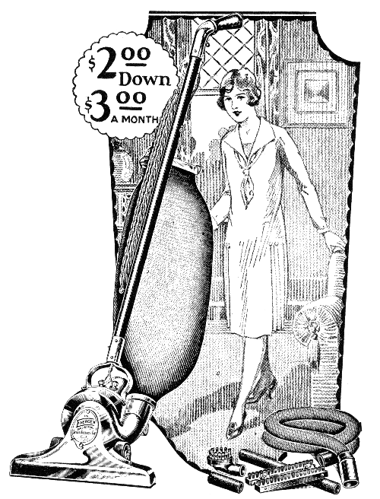
The Consumer Goods Industry
Many new goods and products became available to Americans who had “disposable” income (extra-money):
Electric Razors
Disposable facial tissue
Frozen food
Home hair dye
Cleaning products (spurred by indoor plumbing)
Electric Irons
Vacuum Cleaners
Washing Machines
Refrigerators
Gas Stoves
Improved Glass Cookware
Fashion
Personal Appearance Items
Notes:
•

Slide 7
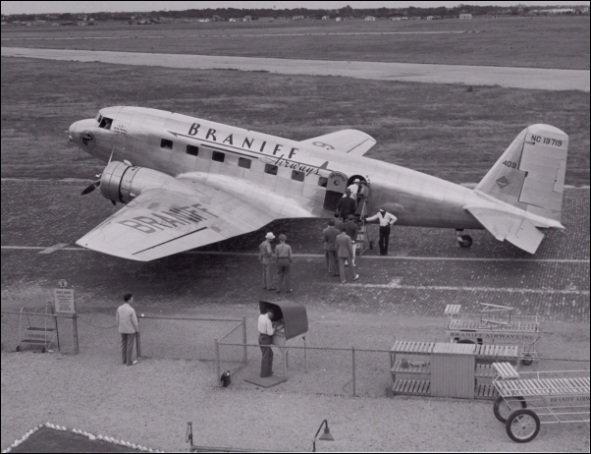
The Airline Industry
Did not “take off” as fast as the automobile industry
People thought airplanes were flimsy, unsafe, and just a novelty
Starting in 1918 the USPS used airplanes to fly mail between Washington DC and New York.
The Air Commerce Act: offered federal aid to build airports
In 1927 Charles Lindbergh flew solo across the Atlantic boosting the airline industry.
By 1928, 48 airlines flew to
355 US cities regularly.
Notes:
•
•
•
•

Slide 8
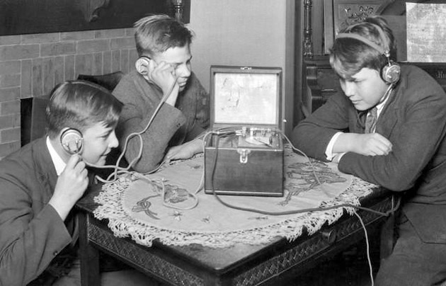
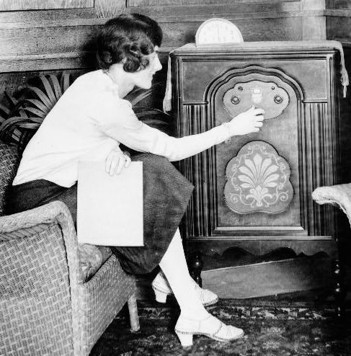
The Radio Industry
1926-National Broadcasting Company (NBC)
1927-Columbia Broadcasting System (CBS)
The 1928 Presidential Election Campaign was aired on the radio for the first time nationwide.

Slide 9
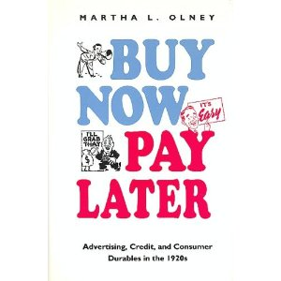
The Consumer Society
Americans shifted from “thrift” and “prudence” to consumerism
Easy Consumer Credit
Individuals borrowed money to “get it now and pay for it later”
Mass Advertising
The Managerial Revolution
Welfare Capitalism: Companies allowed workers to buy stock, participate in profit sharing, and receive benefits such as medical care and pensions.
Unions seemed unnecessary.
Workplaces where employees were hired without having to join a union became known as “open shops”.
Notes:
Mass Advertising: created consumers for new products (i.e.: Bread slicer for sliced bread. Without advertising no one knew that they needed sliced bread.)
The Managerial Revolution: New ways to divide companies that allowed the company to grow without bounds.
Managers ran the day-to-day operations. Executives could then make long-range plans.

Slide 10
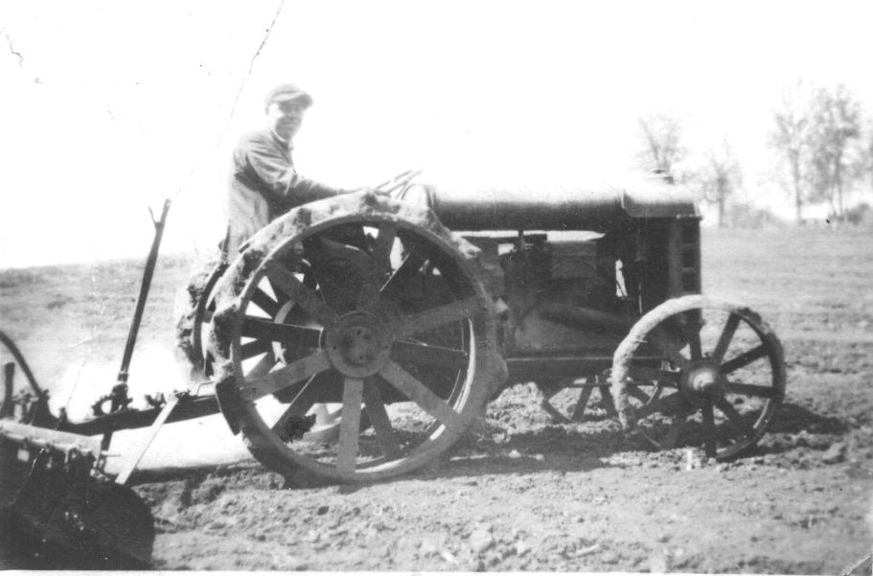
The Farm Crisis Continues…
Farmers earned less than 1/3 of the average worker. ($333 dollars a year compared to $999)
During the war farmers were encouraged to grow more for the war effort. Afterwards there was a surplus of crops driving the prices down.
The Fordney-McCumber Act raised tariffs which made it difficult for farmers to sell products overseas.
To try and help farmers, congress passed the McNary-Haugen Act twice. President Coolidge vetoed the act both times.
Notes:
McNary-Haugen Act: The US government would buy crops from farmers and sell them overseas (in effect by-passing the Fordney-McCumber Act for farm products)
Coolidge Vetoes: he believed the farmers would be encouraged to produce even more crops and the government would have a hard time selling those crops in oversea markets which were already glutted.

Slide 11
Review Questions
How does an assembly line work?
What tradition did International Harvester start?
What was Ford’s Sociological Department created to do?
What was Ford’s philosophy towards increasing sales?
How did most Americans feel about the airplane?
How did Charles Lindberg change how Americans felt about the airplane?
What was welfare capitalism?

Slide 12
Essay Question
How did the automobile affect American business and society in the 1920s?

Slide 13
Essay Question
How did the automobile affect American business and society in the 1920s?
Cars revolutionized American life. The auto industry spurred growth in other large industries, such as rubber, plate glass, nickel, and lead. Automaking alone consumed 15 percent of the nation’s steel, and the flood of cars stimulated a tremendous expansion of the petroleum industry. Cars also created new small-business opportunities, such as garages and gas stations. Cars eased the isolation of rural life, putting towns within reach of many farmers and the countryside a mere ride away for city dwellers. Cars also enabled people to live farther away from work. An entirely new kind of consumer and worker, the auto commuter, appeared. Commuters lived in growing suburban communities and drove to work in the city.

