Slide 1
Settling the West
Native Americans

Slide 2
Learning Targets
Tell the story of the Dakota Sioux uprising and the Lakota Sioux defense of their territory.
Describe the events at Sand Creek.
Discuss what happened at the Battle of Little Big Horn.
Explain why Wounded Knee was such a tragedy.
Express the significance of Helen Hunt Jackson, assimilation, and the Dawes Act.

Slide 3
Culture of the Plains Indians
Nomads
For centuries, the Great Plains was the home of many Native American nations.
Some lived in communities as farmers
Most were nomads—roamed vast distances, following their main source of food—the buffalo
The Plains Indian nations all had a close relationship with nature
They lived in extended family networks
Nations sometimes numbered thousands of people
Divided into bands of 500 with a governing council over each band
The assignment of tasks was divided by gender
Women: domestic tasks—raising children, cooking, preparing hides
Men: hunting, trading, supervising the military life of the band
Religion based on beliefs in spiritual power of the natural world

Slide 4
Cultures Under Pressure
Miners, Ranchers, and Farmers moved onto the Plains
They deprived Native Americans of their hunting grounds
They broke treaties guaranteeing certain lands to the Plains Indians
They forced the Plains Indians to relocate to new territory
Native Americans resisted by attacking wagon trains, stagecoaches, and ranches.
Occasionally an entire group would go to war against nearby settlers and troops.

Slide 5
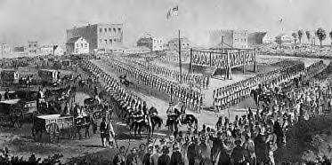
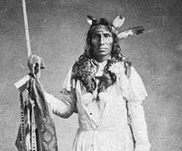
Cultures Under Pressure
-The Dakota Sioux Uprising
The Dakota Sioux agreed to live on a small reservation in Minnesota in exchange for annuities
The government paid the annuity late.
Chief Little Crow asked traders to provide his people food on credit.
Little Crow reluctantly agreed to lead an uprising.

Slide 6
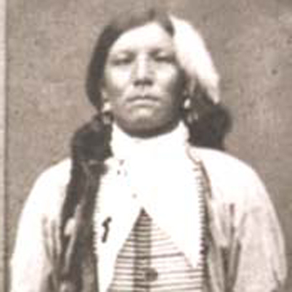
Cultures Under Pressure
-Lakota Sioux Defend Their Territory
The army sent patrols far out onto the northern Great Plains to prevent trouble among the Sioux there.
Crazy Horse, a religious leader as well as a war chief, lured the troops into a deadly trap. He tricked the fort’s commander into sending Captain William Fetterman and about 80 soldiers out to
pursue what they thought was a small
raiding party. Hundreds of warriors were
waiting in ambush and wiped out the
entire detachment.

Slide 7
Cultures Under Pressure
-Sand Creek
In the 1860s, tensions began to rise between Cheyenne and Arapaho peoples and the miners who had flocked to Colorado in search of gold and silver.
John Evans, ordered the Native Americans to surrender at Fort Lyon.
Chief Black Kettle brought several hundred Cheyenne to the fort, not to surrender but to negotiate a peace deal.
Colonel John Chivington of the Colorado Volunteers was ordered to attack the Cheyenne at Sand Creek.
When Chivington stopped at Fort Lyon, he was told that the Native Americans at Sand Creek were waiting to negotiate. Chivington replied that since the Cheyenne had been attacking settlers, including women and children, there could be no peace.

Slide 8
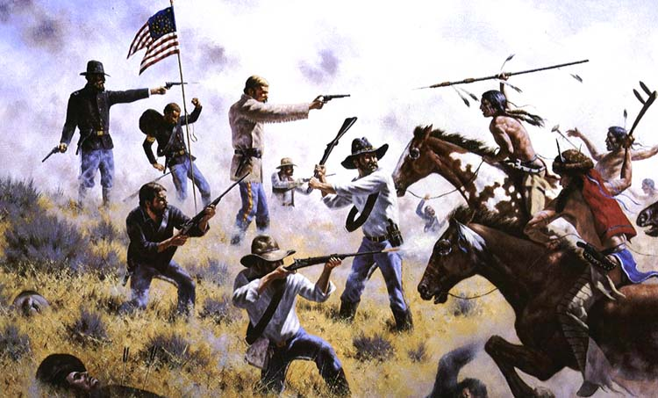
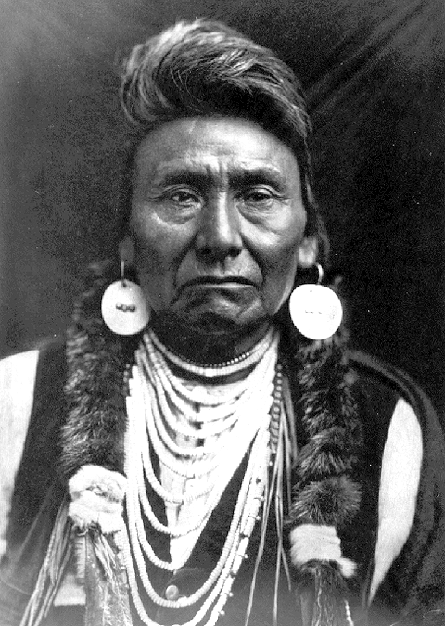
The Last Native American wars
-Battle of the Little Bighorn
Lieutenant Colonel George A. Custer, commander of the Seventh Cavalry, was with the expedition.
Custer underestimated the fighting capabilities of the Lakota and Cheyenne.
Farther west, members of the Nez Perce, led by Chief Joseph, refused to be moved to a smaller reservation in Idaho in 1877.
Chief Joseph surrendered.

Slide 9
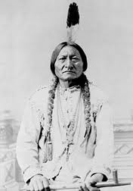
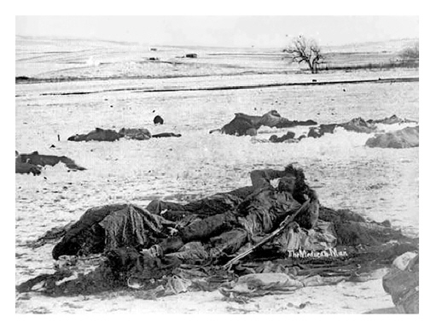
The Last Native American wars
-Tragedy at Wounded Knee
Defying the orders of the US government, the Lakota continued to perform the Ghost Dance, a ritual that celebrated a hoped- for day of reckoning when settlers would disappear, the buffalo would return, and Native Americans would reunite with their deceased ancestors.
Gunfire broke out killing 25 soldiers and 200 Lakota.
Sitting Bull died in an exchange
of gunfire.

Slide 10
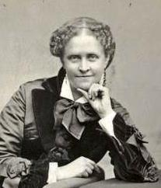
Assimilation
Author Helen Hunt Jackson described the years of broken promises and assaults on Native Americans in her book, A Century of Dishonor, sparked discussions- even in Congress- of better treatment for Native Americans.
The Daws Act allotted to each head of household 160 acres of reservation land for farming; single adults received 80 acres, and 40 acres were allotted for children. The land that remained after all members had received allotments would
be sold to American settlers,
with the proceeds going
into a trust for Native Americans.

Slide 11
Review Questions
What was the story of the Dakota Sioux uprising and the Lakota Sioux defense of their territory?
Describe the events at Sand Creek.
What happened at the Battle of Little Big Horn?
Why was Wounded Knee was such a tragedy?
Express the significance of Helen Hunt Jackson, assimilation, and the Dawes Act. Were they successful?

Slide 12
Essay Question and Answer:
Describe the agreement the Dakota Sioux had made with the United States government and the reasons for their uprising.
The Dakota Sioux had agreed to live on a small reservation in Minnesota in exchange for annuities, on regular payments, from the United States government. The payments, however, were small, and much of the money ended up in the hands of white traders. These traders often claimed fabricated debts owed them by the Dakota and took the annuities in payment. Congress made things worse in 1862 by delaying the payments. As a result, some of the Dakota were starving. The Dakota rose up and slaughtered settlers in the area before troops put down the uprising.

