Slide 1
Politics of protest Chapter 26 Jeopardy
Created by: Mark Z, Devon, Timur, and Cooper
#AMHSJEOPARDYFLOW

Slide 2
Politics of Protest
Earth
Women’s Rights
Civil Rights
Society
Other
100
100
100
100
100
200
200
200
200
200
300
300
300
300
300
400
400
400
400
400
500
500
500
500
500

Slide 3
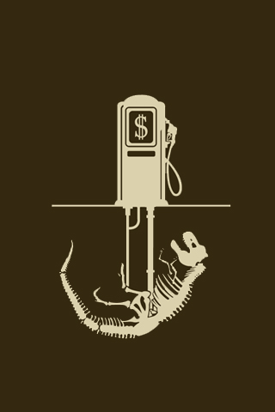
Supporters of nuclear energy hailed as a cleaner and less expensive alternative to… – 100 Points
What are fossil fuels?
#AMHSJEOPARDYFLOW

Slide 4
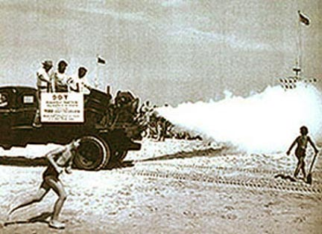
Scientists established the Environmental Defense Fund and used its contributions for a series of legal actions across the country to halt…– 200 Points
What is DDT spraying?
#AMHSJEOPARDYFLOW

Slide 5
Many observers point to April 1970, as the clearest beginning of the environmental movement with the celebration of…– 300 Points
What is earth day?
#AMHSJEOPARDYFLOW

Slide 6
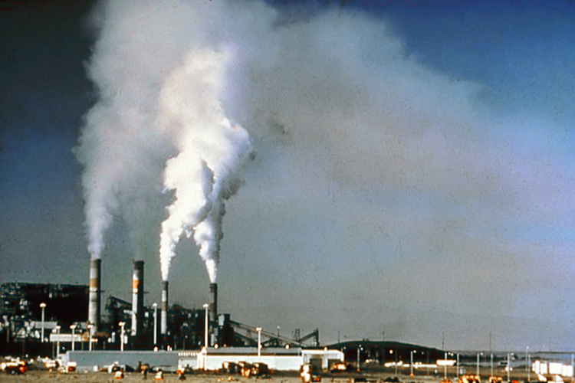
What act established emissions standards for factories and automobiles– 400 Points
What is the clean air act?
#AMHSJEOPARDYFLOW

Slide 7
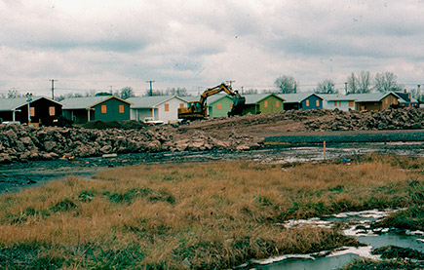
The residents soon learned that their community sat atop a decades-old toxic waste dump. Over time its hazardous contents had leaked into the ground– 500 Points
What is the Love Canal?
#AMHSJEOPARDYFLOW

Slide 8
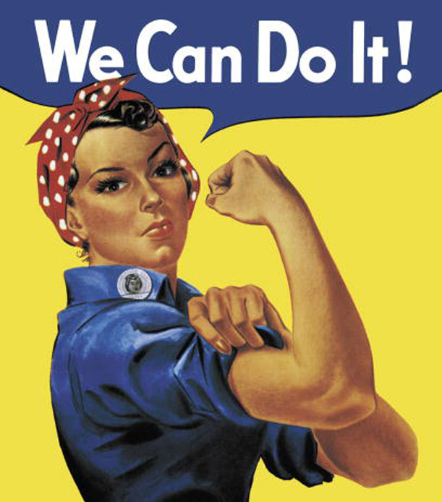
One of the forces that helped bring the women’s movement to life was this. – 100 Points
What is the presidents Commission of the status of women?
#AMHSJEOPARDYFLOW

Slide 9
A new organization, the idea of Betty Friedan, reflected the diverse goals of the modern feminist movement and was named the– 200 Points
What is the National Organization for Women?
#AMHSJEOPARDYFLOW

Slide 10
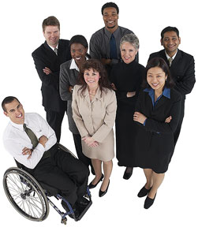
What outlawed job discrimination by private employers not only on the basis of race, color, religion, and national origin, but also of gender– 300 Points
What is the Equal Employment Opportunity Act?
#AMHSJEOPARDYFLOW

Slide 11
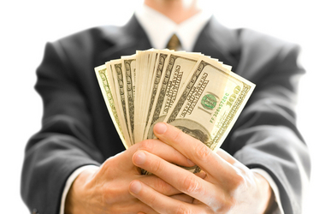
Although about 47 percent of American women were in the workforce in the 1960s, generally they were shut out of– 400 Points
What are higher paying and prestigious professions?
#AMHSJEOPARDYFLOW

Slide 12
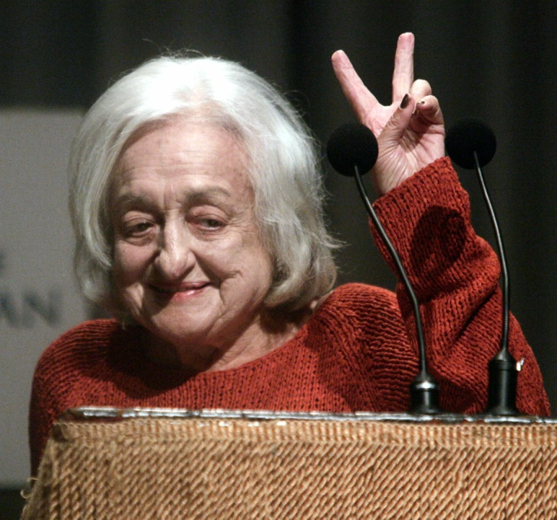
Betty Friedan and others set out to form this.– 500 Points
What is the National Organization for Women (NOW)?
#AMHSJEOPARDYFLOW

Slide 13
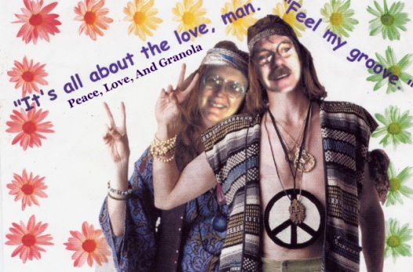
The movement was sparked in Berkeley, California, when the university decided to restrict the student’s rights to distribute literature and to recruit volunteers for political causes on campus.– 100 Points
What is the free speech movement?
#AMHSJEOPARDYFLOW

Slide 14
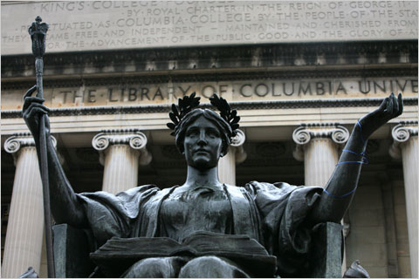
Where SDS leaders orchestrated an eight-day occupation of several buildings to protest the administration’s plan to build a new gym in an area that served as a neighborhood park. – 200 Points
What Are Columbia university in New York city?

Slide 15
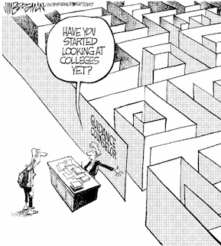
The early 1960s saw a phenomenon that fueled the youth movement-the rapid increase in– 300 Points
What are college enrollments?

Slide 16
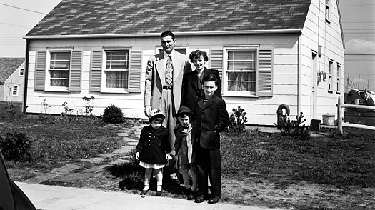
The 1960s gave birth to a conspicuous youth movement, which challenged the American political and social system and conventional– 400 Points
What are middle class values?
#AMHSJEOPARDYFLOW

Slide 17
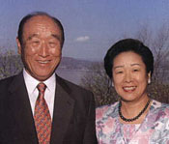
Many of the religious groups embraced by members of the counterculture centered around– 500 Points
What are authoritarian leaders?
#AMHSJEOPARDYFLOW

Slide 18
Leaders of the civil rights movement began to focus their energies on gaining good jobs for African Americans and– 100 Points
What is an adequate education?
#AMHSJEOPARDYFLOW

Slide 19
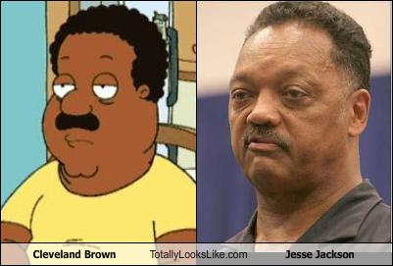
Who founded People United to Save Humanity, or PUSH, a group aimed at registering voters, developing African American businesses, and broadening educational opportunities?– 200 Points
Who is Jesse Jackson?
#AMHSJEOPARDYFLOW

Slide 20
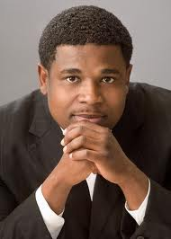
An affirmative action called for companies and institutions doing business with the federal government to actively recruit them.– 300 Points
What are African American employees?
#AMHSJEOPARDYFLOW

Slide 21
were kept from jobs, promotions, and a place in schools because a certain number of such positions had been set aside for minorities or women– 400 Points
What are qualified white workers?
#AMHSJEOPARDYFLOW

Slide 22
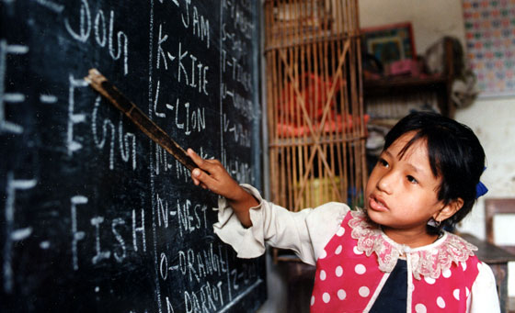
By the early 1970’s, Civil Rights leaders began to push harder– 500 Points
What are adequate education and gaining good jobs.
#AMHSJEOPARDYFLOW

Slide 23
The big change in abortion laws came with the 1973 Supreme Court decision in– 100 Points
What is Roe v. Wade?
#AMHSJEOPARDYFLOW

Slide 24
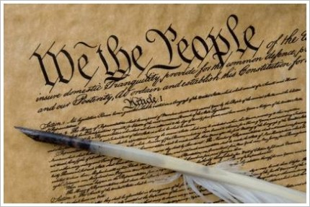
The Indian civil rights act recognized the legitimacy of local reservation law and guaranteed reservation residents the protection of this.– 200 Points
What is the bill of rights?
#AMHSJEOPARDYFLOW

Slide 25
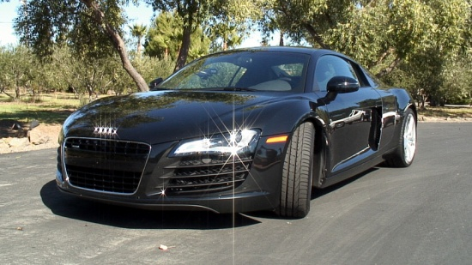
Congress passed the National Traffic and Motor Vehicle Safety Act in 1966 and for the first time set federal safety regulations for the– 300 Points
What is the automobile industry?
#AMHSJEOPARDYFLOW

Slide 26
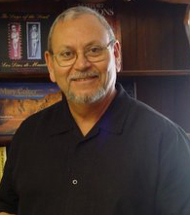
Who founded the political party La Raza Unida, which called for job-training programs and greater access to financial institutions?– 400 Points
Who is Jose Angel Gutierrez?
#AMHSJEOPARDYFLOW

Slide 27
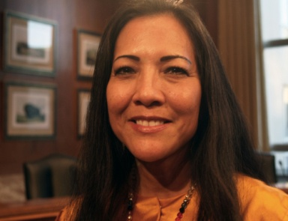
The conditions that led the native Americans to organize in the 1960’s – 500 Points
What is low income, unemployment, and low life expectancy due?
#AMHSJEOPARDYFLOW

