Slide 1
Proteins and Denaturation Learning Targets: * Understand denaturation of protein * Tell some of its causes and effects

Slide 2
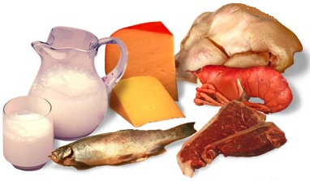
Complete protein comes from animal products

Slide 3
Incomplete protein comes from the SEEDS of plants: nuts, beans, seeds, and grains.

Slide 4
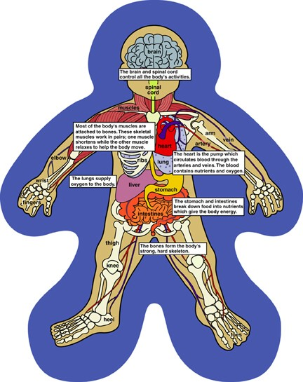
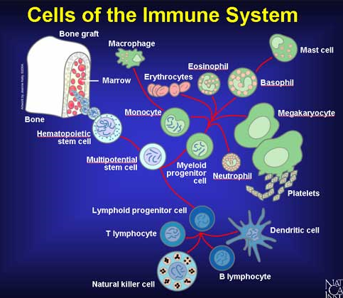
Proteins perform many functions in our bodies. Our cell structure is based on protein, and proteins form the hormones and enzymes that help our bodies work.

Slide 6
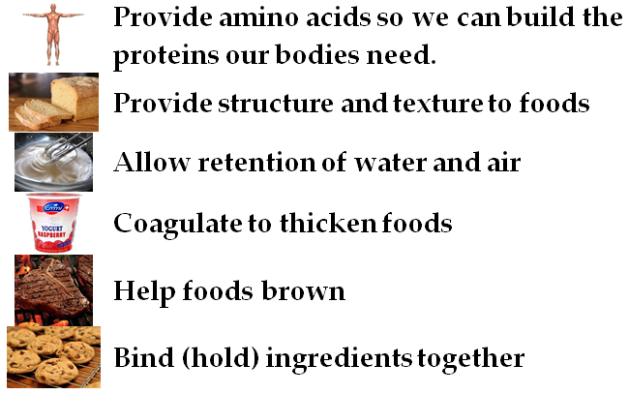
Proteins also perform important functions in food:

Slide 7
With your partner, discuss at least 3 functions proteins perform in food.

Slide 8
Proteins are complicated molecules.
Proteins are made of strings of amino acids held together by covalent bonds.
Those strings are pleated and spiraled by hydrogen bonds.
Additional bonding occurs between those pleats and spirals, folding the protein.

Slide 9
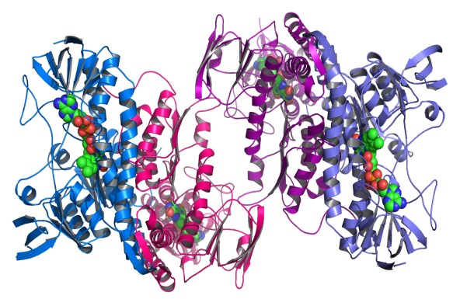
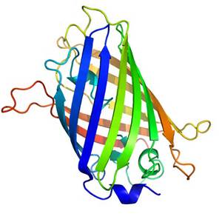
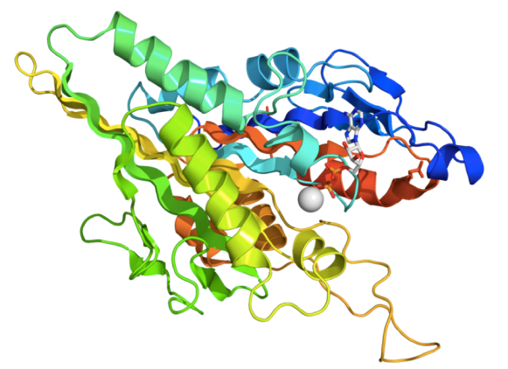
“Each protein has its own unique sequence of amino acids and the attractions between these amino acids create a specific shape. This shape determines the protein's function, from digesting protein in the stomach to carrying oxygen in the blood.
https://www.boundless.com/biology/biological-macromolecules/proteins/denaturation-and-protein-folding/

Slide 10
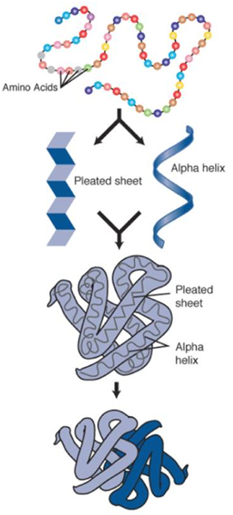
Start at 5:00 to see how the necklace of amino acids coils into a protein.

Slide 11
If the protein is subject to changes in temperature, pH, or exposure to chemicals, the weak attractions between amino acids may alter the shape of the protein. Although the primary structural sequence does not change, the protein's shape may change so much that it becomes dysfunctional and the protein is considered denatured .”
https://www.boundless.com/biology/biological-macromolecules/proteins/denaturation-and-protein-folding/

Slide 12
De = remove, opposite To DE-NATURE a protein is to remove its natural charactieristics.

Slide 13
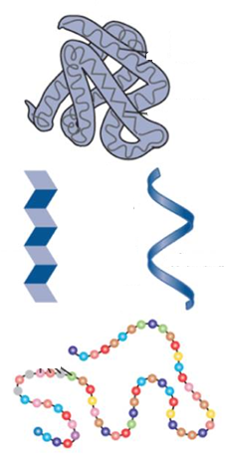
When a protein becomes DENATURED, some of its bonds begin to break, and it ufolds.
Bonds that held the folding weaken.
Bonds that created the spirals and pleats weaken.
Covalent bonds that held the amino acids together remain.

Slide 14
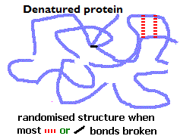
In this unfolded state, the protein does not still have its original nature and characteristics.

Slide 15
Discuss with your partner:
What does “de-nature” mean?
What happens to a protein when it becomes denatured?

Slide 16
Because many of the proteins original bonds have been broken, those parts of the molecule are now available to make new bonds with other substances. This changes the way the molecule reacts.

Slide 17
Since a protein’s function is dependent on its shape, a denatured protein is no longer functional. It is not biologically active, and cannot perform its natural function.

Slide 18
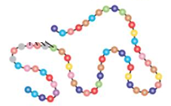
Because proteins keep their amino acid structure, it is sometimes possible to reverse denaturation if it has been gentle.

Slide 19
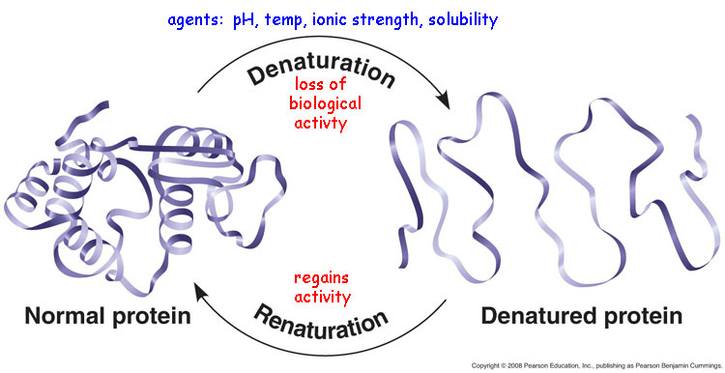
If the denaturing was very gentle, when the denaturing agent is removed, the original attractions between the amino acids reshape the protein and it can resume its function.

Slide 20
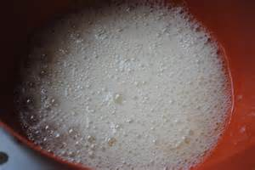
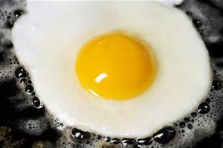
More often, denaturation is so extreme that it cannot be reversed. Proteins that have coagulated can not become renatured.
Proteins in a slightly beaten egg can refold.
Proteins in a
cooked egg cannot.

Slide 21
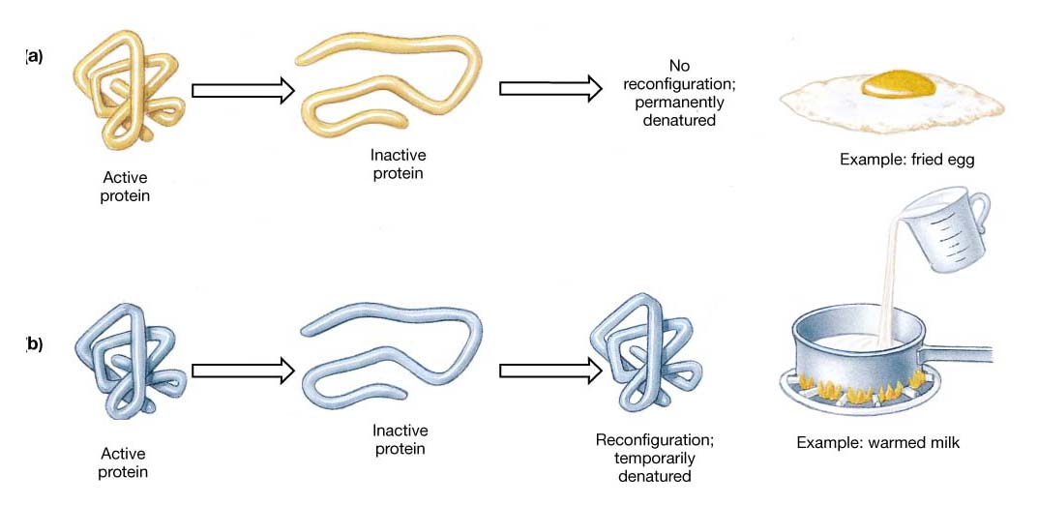
Not all proteins react alike.

Slide 22
Although a denatured protein can not function biologically, it can have important functions in food.

Slide 23
Effects of denatuation: *Loss of biological activity. *Greater digestability. *Destruction of toxins. *Increased viscosity. *Decreased solubility. *Changes in ability to bind water. *Inability to crystalize.

Slide 24
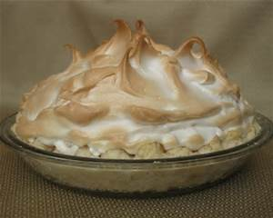
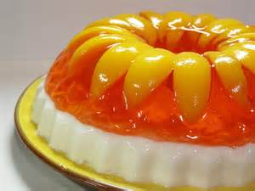
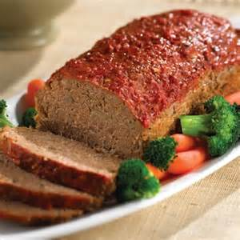
These can be important in cooking.
*binding
*incorporating air *setting and gelling
*browning and
other color changes

Slide 25
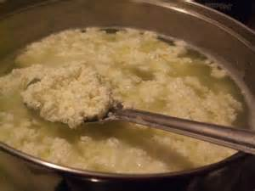
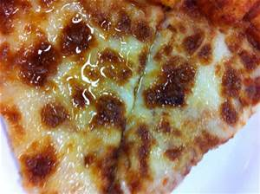
Denaturation can also cause problems in cooking.
Curding of protein foods
Leaking, or “weeping” of liquids

Slide 26
In cooking, is denaturation of protein helpful, or does it cause problems?

Slide 27
The following slides show some of the things that can denature protein.

Slide 28
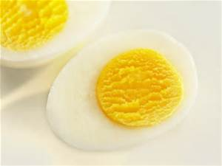
Agents of denaturation:
Extremes of temperature
(Heating foods can make them safer to eat by denaturing the proteins of bacteria.)

Slide 29
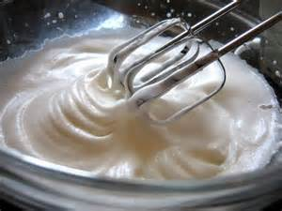
Mechanical agitation
Agents of denaturation:

Slide 30
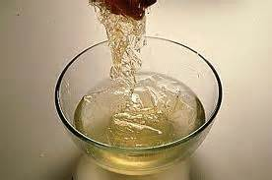
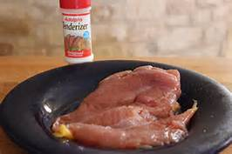
Changes in pH.
Agents of denaturation:
Acidic juice keeps gelatin from setting.
Acidic tenderizers can help make meat more tender.

Slide 31
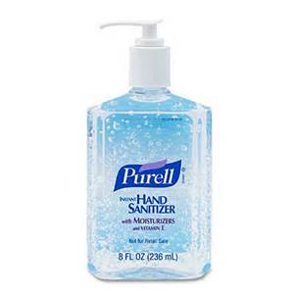
Alcohol/ Organic solvents
Agents of denaturation:
Your hand sanitizer kills germs by denaturing the proteins in them.

Slide 32
With your partner, identify 4 things that can denature protein.

Slide 33
Have you reached our
learning targets?
1. Define denaturation of protein 2. Tell some of its causes and
effects

Slide 34
Denaturation review at: https://www.youtube.com/watch?v=3IL_Df5ouUc

