Slide 1
The Great Depression Begins
Causes of the Depression

Slide 2
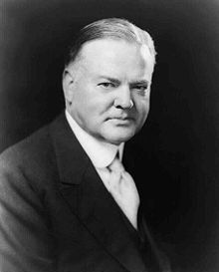
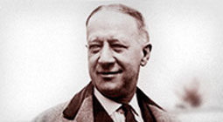
American Prosperity
During the “Roaring Twenties” most Americans enjoyed great prosperity and as such, elected Herbert Hoover to continue the republican run in the White House.
Alfred E. Smith ran for president against Herbert Hoover in 1928 but lost because he was Catholic. He was know as the “wet” candidate.

Slide 3
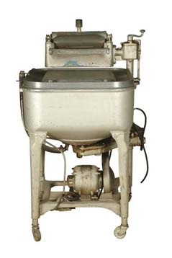
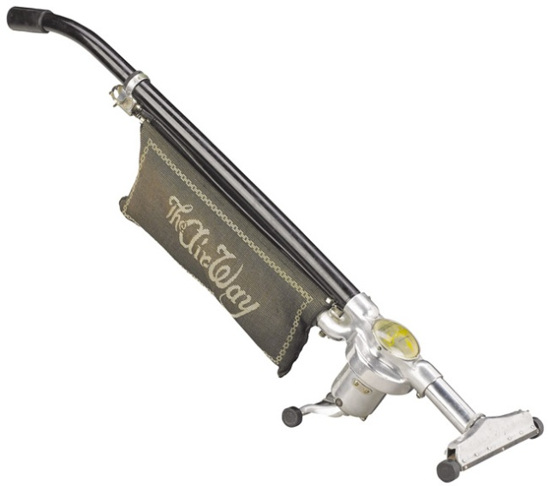
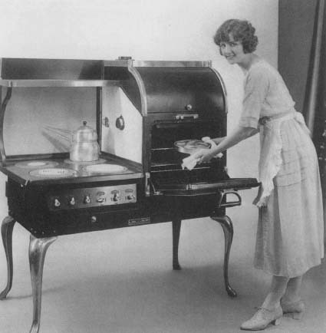
American Prosperity
New inventions made life easier and gave people more free time and more freedom to do other activities.
Some people had extra money to spend, but even if they didn’t, they bought things on credit.
Buying things on credit (called the installment plan) created a demand for more products.
Many companies produced mass amounts of products in anticipation that people would continue to buy, buy, buy…
This gave lots of people jobs…and with their job, more money to spend…
Anticipating that people would continue to buy, buy, buy… companies produced products in large quantities.

Slide 4
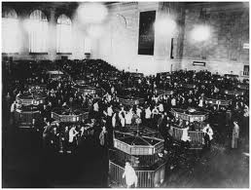
American prosperity
The Stock Market: established as a system for buying and selling shares of companies
Many people bought stock (parts of companies) with their extra money (some people even borrowed money to buy stock)
When a company became worth more money, people could sell the stock they bought and make a profit…then they would buy more.
Businesses and Banks also got in on the action of making money on stocks.
Some people even borrowed money to buy stocks and put only a down payment on the stock (called buying on “margin”)
This was risky because a bank could demand full payment at any time (called a “margin call”)

Slide 5
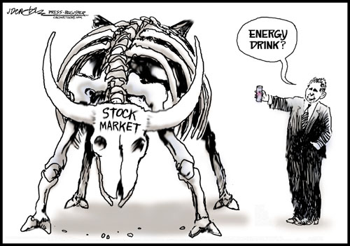
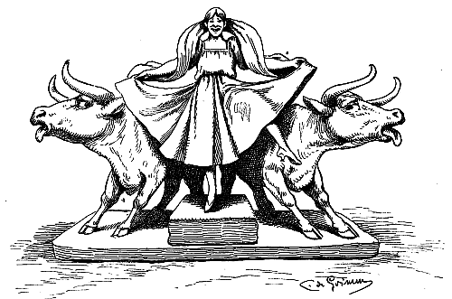
The Long Bull Market
A long period of rising stock prices, which is known as a bull market.
Buyers, hoping to make a fortune overnight, engaged in speculation.
Instead of investing in the future of the companies whose shares they bought, speculators took risks, betting that the market would continue to climb, thus enabling them to sell the stock and make money quickly.

Slide 6
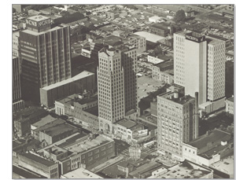
The Great Crash
-Banks in a Tailspin
The market crash severely weakened the nation’s banks in two ways.
Many banks had lent money to speculators to buy stocks
Many banks had invested depositor’s money into the stock market
For some banks, the losses they suffered in the crash were more than they could absorb, and they were forced to close.
The day the sock market crashed became known as Black Tuesday

Slide 7
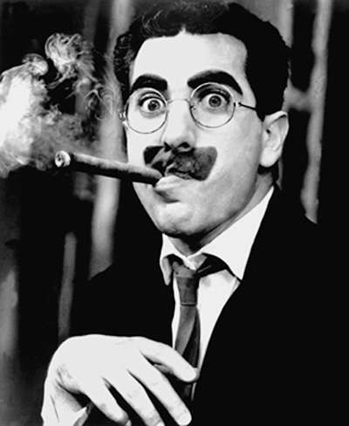
The Roots of the Great Depression
-The Uneven Distribution of Income
During the 1920s many Americans bought high-cost items, such as refrigerators and cars, on the installment plan, under which they would make a small down payment and pay the rest in monthly installments. Some buyers reached a point where paying off their debts forced them to reduce other purchases. This low consumption then led manufacturers to cut production and lay off employees.
Jobless workers had to cut back purchases, further reducing sales. This kind of chain reaction put more and more Americans out of work.
Banks foreclosed on people’s homes when they could not afford to pay the bank their house payment each month. The bank took ownership of the house as payment and the family had to move out.
Groucho Marx was a comic star of both the stage and the screen who lost everything in the stock market crash

Slide 8
Essay Question
Use the example depicted in the diagram to explain how buying on margin works, and its risks and rewards.

Slide 9
Essay Question
Use the example depicted in the diagram to explain how buying on margin works, and its risks and rewards.
When buying stock on margin, investors made only a small cash down payment—as low as 10 percent of the price. With $1,000, an investor could buy $10,000 worth of stock. The other $9,000 would come as a loan from a stockbroker. If the stock price rose to, say, $12,000, the investor could sell it, pay off the $9,000 loan, and make a quick $2,000 profit on the $1,000 investment. However, if the stock price dropped to, say, $8,000, the broker might issue a margin call, demanding the investor repay the loan at once. In this case, the investor may not be able to repay the loan. After selling the stock and giving the broker $8,000, the investor would still have to come up with $1,000 of his or her own money to pay off the $9,000 loan. Not only would the investor have lost his or her initial $1,000 investment, but with the additional $1,000 paid to the stockbroker, the investor’s total loss would be $2,000.

Slide 10
Essay Question
Discuss three major causes of the Great Depression.

Slide 11
Essay Question
Discuss three major causes of the Great Depression.
Most economists agree that overproduction was a key cause of the depression. Increasingly efficient machinery greatly sped the production of factory and farm goods. Most Americans, however, did not earn enough to buy up the flood of goods they helped produce. As consumers bought more on the installment plan, the debt forced some to reduce their other purchases. As sales slowed, manufacturers cut production and laid off employees. Jobless workers had to cut back purchases even more, causing business activity to spiral downward. A second cause was the loss of export sales. American banks were making lucrative loans to speculators instead of to foreign companies. This fact, along with the Hawley-Smoot Tariff that dampened foreign sales in the United States, caused foreign sales in the United States, caused foreign companies to have less to spend on American products. A third cause was mistakes by the Federal Reserve. Instead of raising interest rates to curb excessive speculation, it lowered rates. This action encouraged banks to make risky loans and encouraged businesses to borrow more money to expand production, adding to the problem of overproduction.

Slide 12
Essay question
Use the diagram to help you explain how banks operate and why runs on banks can result in bank failure.
$$$$ Deposits $$$$ >>>> Bank >>>> $$$$ loans $$$$

Slide 13
Essay question
Use the diagram to help you explain how banks operate and why runs on banks can result in bank failure.
$$$$ Deposits $$$$ >>>> Bank >>>> $$$$ loans $$$$
Most banks make a profit by lending out money received from depositors and collecting interest on the loans. The bank holds only a fraction of the depositors’ money to cover everyday business, such as occasional withdrawals. Ordinarily that reserve is enough to meet the bank’s needs, but if too many people withdraw their money at the same time, the reserves will not be sufficient to cover the withdrawals, and the bank will eventually collapse.

